Slide 1
.NET Foundation Education Committee
May 19, 2021

Slide 2
Agenda
Introduction
Background on “.NET Bootcamp”
“.NET Bootcamp” initiative
Naming of the initiative
Scheduling a recurring meeting
Education committee membership process
Communication process
Promoting the education committee/bootcamp initiative
High level overview of important tasks for Fall cohort

Slide 3
Introduction
Chairperson(s): Brian Jablonsky
Mission statement:
The education committee is responsible for developing, sponsoring, and providing educational opportunities for the .NET community.
Repository: https://github.com/dotnet-foundation/wg-education
Our first initiative will be creating and running a “.NET Bootcamp” for university CS students

Slide 4
Background on .NET Bootcamp
Brian volunteered with a local university that offered a yearlong technical and professional development program for the university’s computer science students to learn in-demand technologies (JavaScript)
Began developing a .NET focused course based on the current program’s curriculum
Taught pilot course in fall of 2020 to 5 students for 12 weeks
Pitched idea to .NET Foundation board in January 2021 and approved

Slide 5
“.NET Bootcamp” Initiative
The goal of this initiative is to create and run a 12-week course that teaches full stack web development using .NET for current computer science students who already understand computer programming fundamentals
Targeting fall 2021 (September – December) for first cohort
Limited scope
We’re currently targeting students who are currently enrolled in a higher education computer science program
We’d love to expand the curriculum and program in the future to include other .NET technologies (AI/ML/Desktop/Mobile/etc) and to create a full program to teach .NET to anyone who doesn’t already have computer programming fundamentals, but it would be a massive undertaking. I have already created a lot of the teaching material for the full stack .NET web development course
Will be taught online, once a week, with ~2.5 hours lecture/workshop classes for 12 weeks

Slide 6
“.NET Bootcamp” Initiative
Once the first cohort is finished, offer the teaching materials and training to other colleges/universities around to the world to teach locally
Continue to run and (hopefully) expand the number of courses run online (and maybe even locally)

Slide 7
Naming of Initiative
Is “.NET Bootcamp” acceptable?
Any ideas on a better name?
Already have dotnetbootcamp assets:
https://twitter.com/dotnetbootcamp @dotnetbootcamp (suspended?)
https://www.dotnetbootcamp.com/
https://www.dotnetbootcamp.org/
https://github.com/dotnet-bootcamp
https://www.instagram.com/dotnetbootcamp/ (suspended?)

Slide 8
Scheduling of Committee Meetings
Suggested bi-monthly meetings until first cohort then reduce to once a month
Days:
1st and 3rd Wednesdays
2nd and 4th Wednesdays
Time:
12PM – 1PM ET / 9AM – 10AM PT / 5PM – 6PM BST

Slide 9
Committee Membership
Should we be open to any .NET Foundation member wanting to join?
Or have a core group/acceptance criteria?

Slide 10
Committee Communication
Open to suggestions
Most communication will be done via Issues on the wg-education repository (https://github.com/dotnet-foundation/wg-education)
Progress can be tracked via Projects
Meetings/slides/minutes can be committed via Code
General info via markdown in Code and Wiki
Membership via (GitHub) Teams, but no discussion
Meetings via Microsoft Teams

Slide 11
Promoting Education Committee
Update the website to include Education committee
Make a blog post
Add to upcoming newsletter (May/June)
Tweet via @dotnetfdn

Slide 12
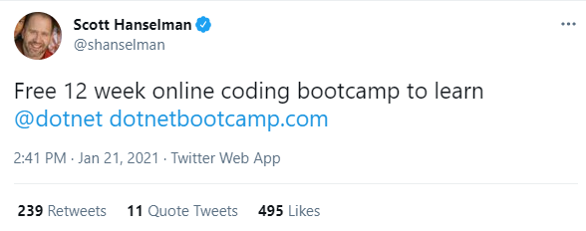
Promoting Bootcamp Initiative
Create a landing page for students to sign up
Set up a mailing list to email students
Already have ~200 sign ups when my original landing page got Hanselman’d

Slide 13
Promoting Bootcamp Initiative
Create a landing page for students to sign up
Set up a mailing list to email students
Already have ~200 sign ups when my original landing page got Hanselman’d

Slide 14
Overview of Tasks
Review course curriculum
Create student application process
Promote .NET Bootcamp
Evaluate applications and accept students
Schedule first course
Enhance/alter existing slide decks and topics (graphics/content/flow/examples)
Enhance documentation
Dry-run each lecture
Sponsorships/demo night

